Slide 1
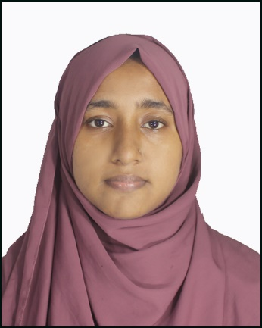




EDUCATION
DEGREE | GPA | BOARD | YEAR
SSC | 4.82 | DHAKA | 2019
HSC | 5.00 | DHAKA | 2021
SYDIA TAMANNA
Current Institution: Department Of Economics, University Of Barishal
PROFILE
PERSONAL INFORMATION
To secure the position of coaching instructor, where I can utilize my expertise in (Bangla, English, Math,) with my strong communication skills, innovative teaching techniques, and dedication to fostering student success. I aim to inspire a love for learning and help students achieve their academic and personal potential.
Date of Birth: 09/10/2002
Marital Status: Unmarried
Religion: Islam
Nationality: Bangladeshi
SKILL
•Problem Solving
•Communication skill
•Hard worker
•Leadership
REFERENCE
CONTACT
Reference: Rezaul Karim ,Faculty of English and Career map Coaching center.
01315398081
syidatamanna@gmail.com

